Slide 1

A Comparative Research on Scalable Machine Learning Models for Fraud Detection Using Big Data Technologies
Name:
Student number:

Slide 2
Introduction
Statement of problem: The rapid rise in digital financial transactions has led to a surge in fraudulent activities, and existing fraud detection methods lack scalability, real-time fraud prevention, and efficiency with large-scale data, creating a need for scalable fraud detection using big data technologies like PySpark. This study aims to bridge the gap in scalable machine learning solutions with PySpark for effective fraud detection and financial security (Bello & Olufemi, 2024).
Background and Rationale: The increasing use of online payment systems and online banking has led to a growing amount of financial data and the potential for fraud in recent years. While existing fraud detection methods may not be able to handle big data effectively and may not capture sophisticated fraud patterns in real time, there is a pressing need for scalable machine learning models using big data technologies like PySpark (Cheng, 2025).
Gaps in current knowledge & core issues
Limited research on scalable fraud detection using distributed big data technologies.
Imbalanced fraud datasets reduce machine learning prediction performance.
Existing models focus more on accuracy than processing efficiency and scalability.
Limited comparison of PySpark-based machine learning fraud detection models.
Possible applications
  Banking fraud monitoring systems.
  Safe online payment systems.
Notes:
This slide introduces the research problem and explains the motivation behind the study. The rapid increase in digital financial transactions and online payment systems has significantly increased fraudulent activities worldwide. Traditional fraud detection approaches often struggle with processing large-scale transaction data efficiently and are unable to detect complex fraud patterns in real time. The slide also highlights major research gaps, including limited scalability analysis, imbalanced datasets, and the lack of comparative studies on PySpark-based fraud detection models. The proposed research aims to address these challenges by developing scalable machine learning solutions that can improve fraud detection accuracy, processing efficiency, and overall financial security.

Slide 3
Research question: How can PySpark-based machine learning models be optimised to deliver scalable, accurate, and computationally efficient fraud detection for large-scale financial transaction data?
Research aim: To develop and evaluate a scalable and efficient fraud detection framework using PySpark-based machine learning models for analysing large-scale financial transaction data in real-time environments.
Research objectives
To preprocess and optimise the fraud detection dataset using PySpark for scalable big data fraud analysis.
To develop and compare PySpark-based Logistic Regression, Random Forest, and Gradient Boosted Trees models for fraud detection.
To evaluate fraud detection performance using precision, recall, F1-score, ROC-AUC, and confusion matrix metrics.
To analyze the scalability, processing efficiency, and real-time performance of machine learning models on large-scale financial transaction data.
Deliverable: A scalable fraud detection analytics developed using PySpark ML pipelines for analysing large-scale financial transactions.
Beneficiaries: Banks, FinTech companies, cybersecurity analysts, and online payment platforms will benefit from improved fraud detection accuracy, faster transaction monitoring, and enhanced financial security.
Notes:
This slide presents the core direction and objectives of the research project. The study aims to investigate how PySpark-based machine learning models can be optimised for scalable and computationally efficient fraud detection on large-scale financial transaction data. The research focuses on preprocessing the fraud detection dataset, developing multiple machine learning models, and evaluating their performance using standard fraud detection metrics. In addition, scalability and real-time processing efficiency will be analysed using distributed computing techniques. The final deliverable will be a scalable fraud detection analytics framework that can support banks, FinTech organisations, and online payment systems in improving transaction security and fraud prevention.

Slide 4
Findings of the literature review
Theme 1: Machine Learning Models for Fraud Detection
    Finding 1 - Logistic Regression is widely used because it is simple, interpretable, and efficient for fraud classification tasks.
    Finding 2 - Random Forest and Gradient Boosted Trees provide higher fraud detection accuracy by handling complex transaction patterns (Gupta et al., 2025).
Theme 2: Big Data Technologies and Scalable Processing
    Finding 3 - PySpark enables distributed processing of large-scale financial datasets with improved computational efficiency.
    Finding 4 - Spark ML pipelines support scalable model training and automated machine learning workflows (Hareram, 2025).
Theme 3: Challenges and Research Gaps in Fraud Detection
    Finding 5 - Fraud datasets are highly imbalanced, causing lower recall and poor minority-class prediction performance.
    Finding 6 - Many previous studies focus mainly on prediction accuracy while ignoring scalability and processing speed analysis (Owen et al., 2024).
Research Gap Addressed
This project addresses the lack of scalable fraud detection research by comparing distributed machine learning models using PySpark on large financial transaction datasets.
Notes:
This slide summarises the key findings from the literature review related to fraud detection and big data analytics. Previous studies show that machine learning models such as Logistic Regression, Random Forest, and Gradient Boosted Trees are commonly used for fraud detection because of their predictive capabilities. Research also highlights the importance of PySpark for handling large-scale datasets through distributed processing. Another major issue identified is class imbalance, which negatively affects fraud prediction performance. However, many existing studies focus mainly on model accuracy and pay limited attention to scalability and computational efficiency. This project aims to address these research gaps using distributed machine learning techniques.

Slide 5

Methodology
  Research Philosophy: Positivist philosophy is selected because the research is based on measurable numerical data, statistical evaluation, and objective machine learning performance analysis.
  Research Approach: An experimental approach is adopted to test existing fraud detection theories and machine learning techniques using the Synthetic Financial Datasets for Fraud Detection dataset.
  Research Methods: A quantitative experimental method is used to evaluate machine learning models through performance metrics and scalability testing using a fraud detection dataset.
  Research Strategy: The strategy includes dataset preprocessing, feature engineering, model training, evaluation, and scalability comparison using PySpark ML pipelines.
  Time Horizon: A cross-sectional time horizon is chosen because the research analyses transaction data collected from an existing dataset within a limited timeframe.
  Tools and Techniques
    Python and PySpark
    Spark MLlib
    Pandas and NumPy
    Matplotlib and Seaborn
    Kaggle Synthetic Financial Dataset
    Logistic Regression, Random Forest, and Gradient Boosted Trees models
Notes:
This slide explains the overall research design adopted for the project. A positivist philosophy is selected because the study relies on objective numerical analysis and measurable results. The research follows a experimental approach by testing existing machine learning theories on the fraud detection dataset. Quantitative experimental methods are used to evaluate model performance and scalability. The research strategy includes data preprocessing, feature engineering, model training, and performance evaluation using distributed PySpark ML pipelines. A cross-sectional time horizon is chosen because the dataset represents existing transaction records. The main tools and technologies include Python, PySpark, Spark MLlib, Pandas, and machine learning algorithms.

Slide 6
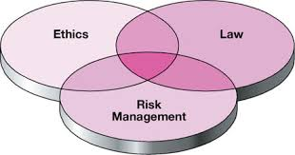
Risks ethics and Issues
Risks
    Large dataset processing may increase training time and computational cost.
    Class imbalance can reduce fraud detection accuracy.
    Risk of model overfitting during training (Wiltshire & Alvanides, 2022).
    Limited hardware resources may affect scalability testing.
Mitigation Measures
    Use PySpark distributed processing for scalability.
    Apply sampling and feature engineering techniques.
    Use cross-validation and parameter tuning.
    Optimise Spark configurations and dataset partitions.
Ethical Issues
    Ensure responsible use of financial transaction data.
    Maintain data privacy and confidentiality.
    Avoid biased fraud prediction models.
    Use datasets only for academic and research purposes.
Issues
    Data quality issues such as missing or inconsistent values.
    Complexity of distributed machine learning implementation.
    Time constraints for training and evaluation of multiple models.
    Need for accurate interpretation of performance metrics and scalability results.
Notes:
This slide discusses the major risks, ethical considerations, and project issues associated with the research. One key risk is the large size of the fraud detection dataset, which may increase processing and training time. This will be managed using PySpark distributed computing and optimisation techniques. Another challenge is class imbalance, which can affect fraud detection accuracy, so sampling methods will be applied. Ethical considerations include maintaining data privacy, avoiding biased predictions, and ensuring responsible use of financial data. Additional issues include data quality problems, hardware limitations, and time constraints during model training and scalability evaluation.

Slide 7
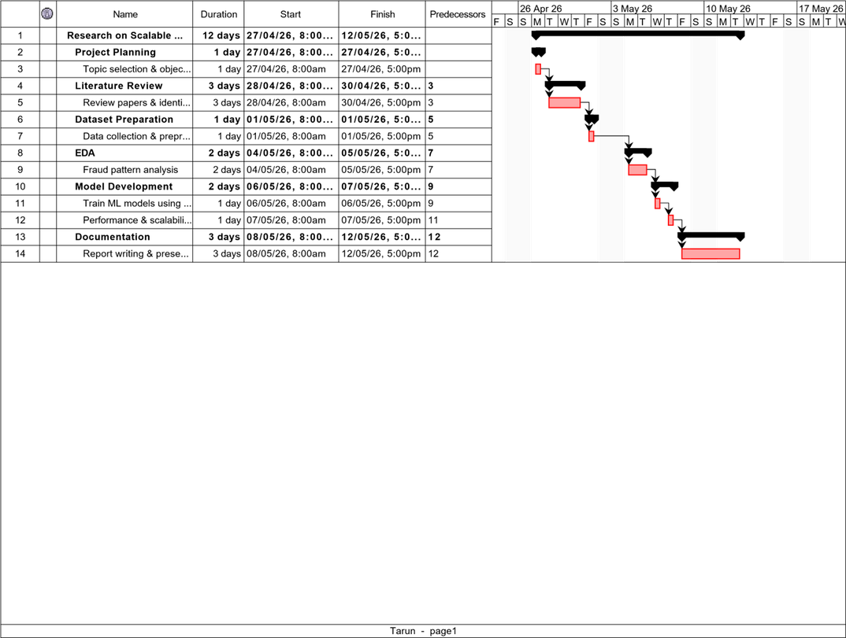
Project Plan
Notes:
This slide presents the project timeline and major milestones planned throughout the research process. The project begins with topic selection, objective definition, and literature review to understand current fraud detection techniques and identify research gaps. The Synthetic Financial dataset will then be collected, cleaned, and preprocessed before performing exploratory data analysis to identify fraud patterns. In the next phase, machine learning models including Logistic Regression, Random Forest, and Gradient Boosted Trees will be developed using PySpark. The models will then be evaluated using multiple performance metrics and scalability testing. Finally, the project concludes with result analysis, report writing, and presentation preparation.

Slide 8
Deliverables and Architecture
Financial Transaction Dataset
Data Acquisition
PySpark Loading
Data Inspection and Cleaning
Feature Engineering
Exploratory Data Analysis
Spark ML Pipeline
Model Evaluation
Scalability Analysis
Final Comparison
Project Deliverables
Scalable PySpark-based fraud detection framework
Pre-processed financial transaction dataset
Three ML models:
  Logistic Regression
  Random Forest
  Gradient Boosted Trees
Model prediction and evaluation results
Confusion matrices and ROC curves
ROC-AUC and performance comparison
Scalability and training-time analysis
Final fraud detection model comparison
The framework is designed to support banks, FinTech companies, cybersecurity analysts and online payment platforms.
Notes:
This slide presents the main deliverables and the overall architecture of my project. The primary deliverable is a scalable fraud detection framework developed using PySpark and Spark MLlib. The system takes financial transaction data as input and processes it through several stages, starting with data acquisition and loading. The next stages involve data inspection, cleaning and feature engineering, followed by exploratory data analysis to understand fraud patterns. After this, the prepared data is passed through the machine learning pipeline. Three models are implemented: Logistic Regression, Random Forest and Gradient Boosted Trees. Finally, the models are evaluated using fraud detection metrics and their computational performance is analysed through scalability testing. The architecture therefore ensures that both predictive performance and processing efficiency are considered.

Slide 9
Tools, Testing and Deployment
Testing
Data validation
Model training and prediction
Performance metrics
Confusion matrices
ROC-AUC
Training time
Scalability testing
Deployment
Functional PySpark research prototype
Executed in development environment
Suitable for future production integration
Area | Tools
Programming | Python
Big Data | PySpark
ML | Spark MLlib
Data Processing | Pandas, NumPy
Visualisation | Matplotlib, Seaborn
Development Environment | Google Colab
Dataset | Kaggle Financial Fraud Dataset
Notes:
This slide explains how the system was developed and tested. The development lifecycle started with collecting and understanding the financial transaction dataset. The data was then cleaned and transformed before feature engineering and exploratory analysis were performed. For implementation, Python and PySpark were used as the main development technologies, while Spark MLlib provided the machine learning functionality. Pandas and NumPy supported data analysis, and Matplotlib and Seaborn were used for visualization. The project was developed and executed in the research environment. Testing covered the complete workflow, including data processing, model training, prediction generation, evaluation metrics, confusion matrices and scalability. The implementation is best described as a functional research prototype rather than a production banking system.

Slide 10
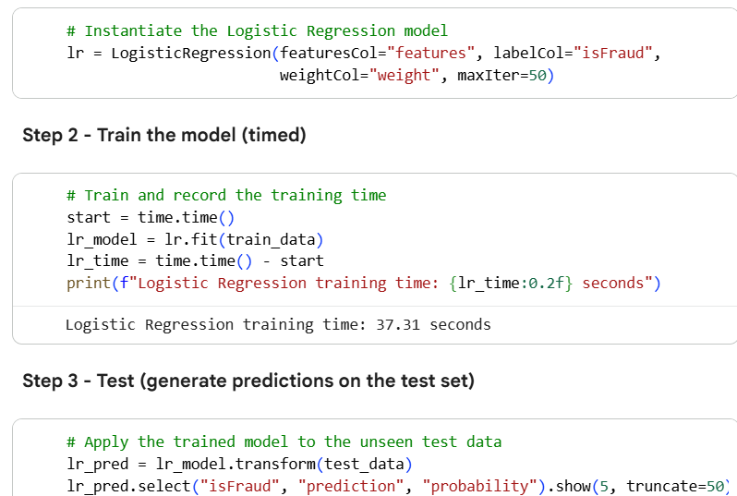
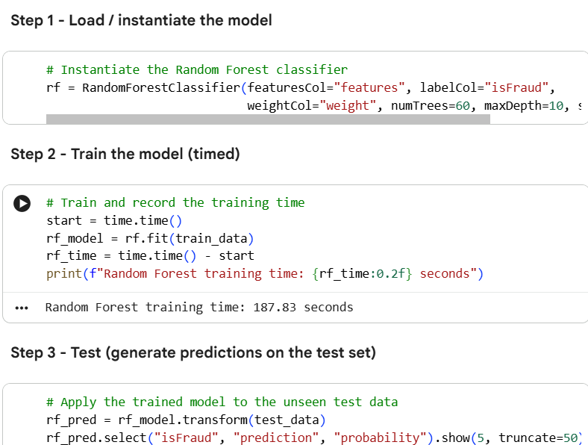
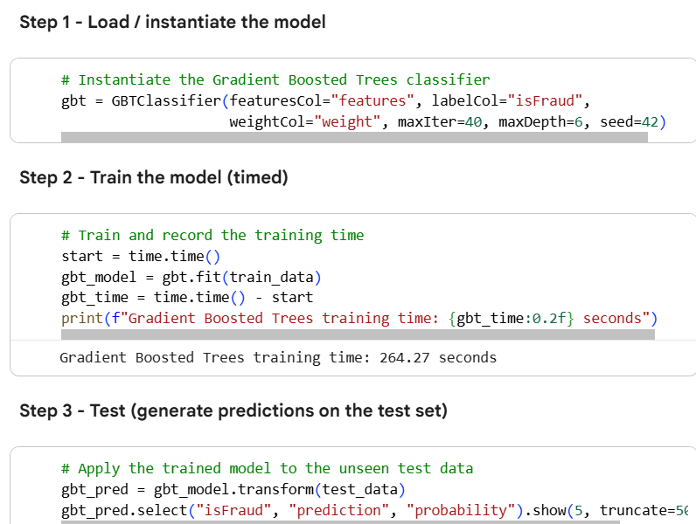
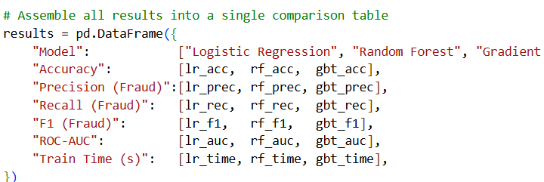
Code Snippets
Notes:
The code shown here demonstrates the implementation of the Random Forest model, logistic regression and Gradient Boosting using Spark MLlib. The models uses the engineered feature vector and fraud-class weighting before being trained on the training dataset.

Slide 11
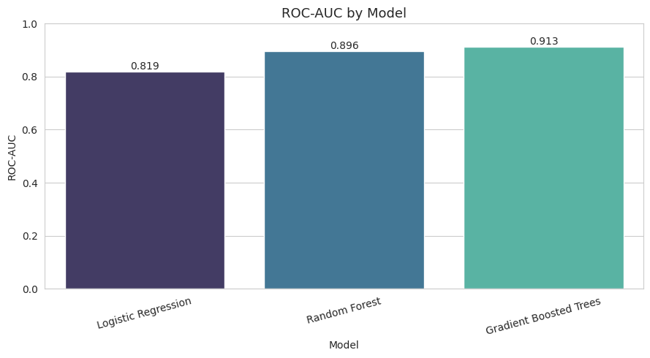
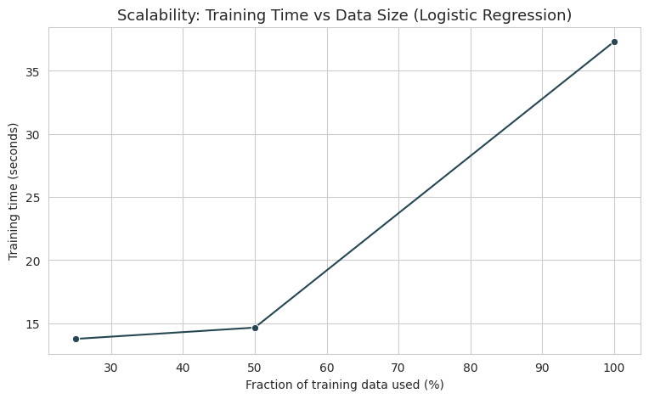
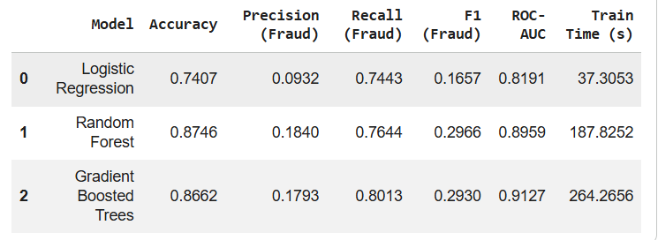
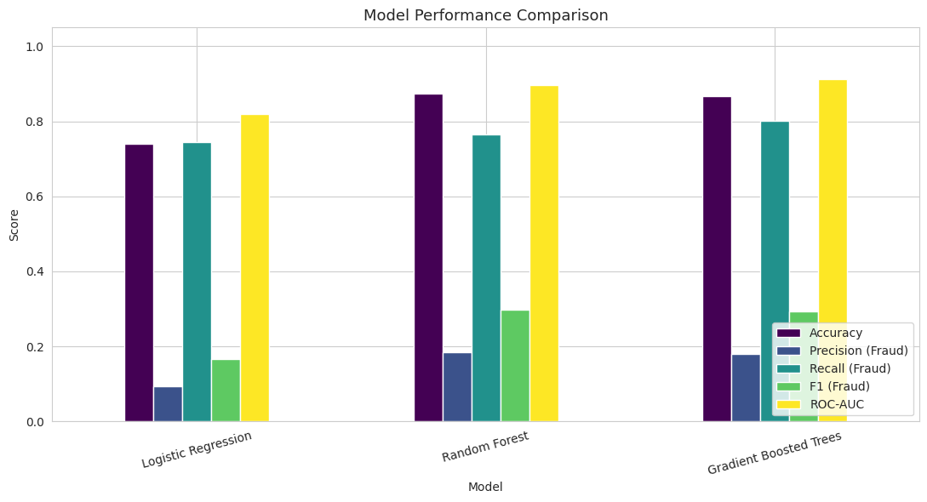
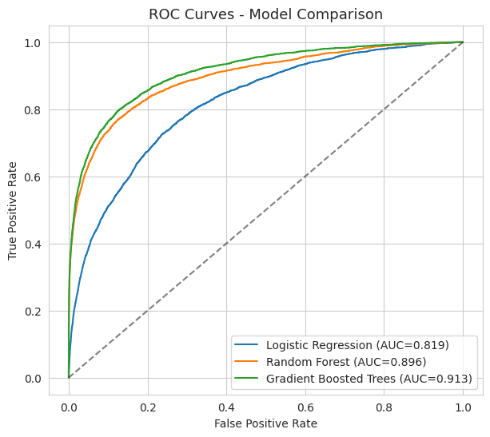
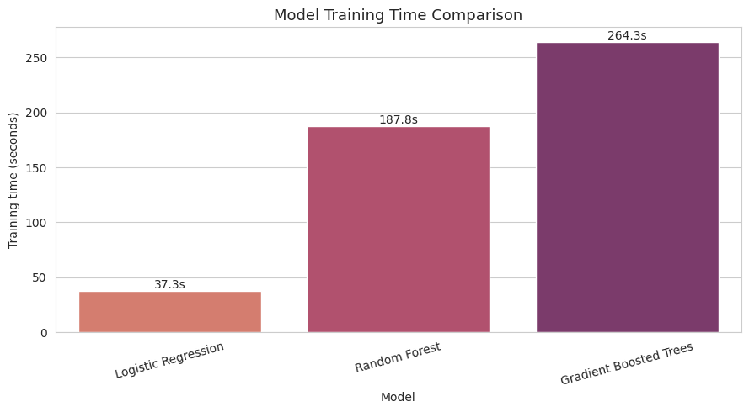
Results
Notes:
Logistic Regression: ROC-AUC 0.8191, fraud recall 74.43%, training time 37.31 seconds.
Random Forest: ROC-AUC 0.8959, fraud recall 76.44%, training time 187.83 seconds.
Gradient Boosted Trees: ROC-AUC 0.9127, fraud recall 80.13%, training time 264.27 seconds.
GBT achieved the best overall fraud-detection performance, particularly in ROC-AUC and fraud recall.
Logistic Regression was the fastest model, demonstrating a clear trade-off between predictive performance and computational efficiency.
Scalability testing was also performed using different proportions of the training data.

Slide 12
Evaluation
User / Potential Beneficiary Evaluation
Evaluation focused on the intended beneficiaries:
  Banks
  FinTech organisations
  Cybersecurity analysts
  Online payment platforms
The evaluation considered accuracy, fraud detection capability, processing efficiency and scalability.
UAT covered:
  Dataset processing
  Model execution
  Fraud prediction
  Performance metrics
  Model comparison
  Scalability testing
Self-Evaluation
Area | Self-Evaluation
Research objectives | Achieved
Dataset preprocessing | Achieved
ML implementation | Achieved
Model comparison | Achieved
Performance evaluation | Achieved
Scalability analysis | Achieved
Real-time deployment | Partially achieved / Future work
External user validation | Not evidenced
Notes:
The evaluation confirms that the implementation remained aligned with the research aim by combining machine learning fraud detection with PySpark-based scalable processing. The project did not focus solely on accuracy; it also evaluated recall, ROC-AUC and computational efficiency, directly addressing the identified research gap. For the systematic evaluation, I assessed the project against its original aim, objectives and research question. The main strength is that the implementation successfully combines PySpark with three machine learning models and evaluates both predictive performance and computational efficiency. However, there are limitations, particularly the computational cost of the more complex models, class imbalance and the absence of production deployment. My self-evaluation therefore considers the core research and implementation objectives achieved, while real-time production deployment and external user validation remain areas for future development.

Slide 13
Conclusion
Lack of large-scale fraud detection research: Addressed by creating a PySpark fraud detection system for financial transaction data.
Limited comparison of PySpark based ML models: Addressed successfully by comparing Logistic Regression, Random Forest and Gradient Boosted Trees.
Focus on accuracy rather than scalability: Addressed by measuring model training time and testing different dataset sizes in addition to predictive performance.
Class imbalance: This is addressed by class weighting, however it is a problem for fraud prediction.
Need for computational efficiency: Training times are compared to demonstrate the computational speed of the model, showing the trade-off between model complexity and processing speed.
Overall: The solution met the key gap in literature, and only a few areas for real-time deployment and testing remain.
Notes:
The project addressed the main literature gaps by implementing a scalable PySpark framework and comparing three machine learning models. Class imbalance was managed using weighting, while scalability and processing efficiency were evaluated alongside accuracy. All four objectives were substantially achieved. Data preprocessing, model development and performance evaluation were fully completed. Scalability testing was also conducted, although real-time production deployment was not fully demonstrated and remains an area for future development.

Slide 14
References
Bello, A., & Olufemi, K. (2024). Artificial intelligence in fraud prevention: Exploring techniques and applications challenges and opportunities. Computer Science & IT Research Journal, 5(6), 1505–1520. https://doi.org/10.51594/csitrj.v5i6.1252
Cheng, C. (2025). Research on Fraudulent Transaction Detection. Applied and Computational Engineering, 158(1), 35– 40. https://doi.org/10.54254/2755-2721/2025.tj23322
Gupta, R., Jindal, R., Naik, A., & Tripathi, A. (2025). Applying Logistic Regression for the Detection of Fraudulent Banking Transactions. ResearchGate, 47(02). https://www.researchgate.net/publication/392331388_Applying_Logistic_Regression_for_the_Detection_of_Fraud ulent_Banking_Transactions
Hareram, S. E. (2025). Technical Review: Apache Spark and PySpark for Distributed Data Processing. ResearchGate. https://doi.org/10.5281/zenodo.16491755
Owen, A., Emma, O., & Adams, R. (2024, October 7). Evaluating the Role of Class Imbalance in Fraud Detection Algorithms. ResearchGate; unknown. https://www.researchgate.net/publication/388817710_Evaluating_the_Role_of_Class_Imbalance_in_Fraud_Detecti on_Algorithms
Wiltshire, D., & Alvanides, S. (2022). Ensuring the ethical use of Big Data: lessons from secure data access. Heliyon, 8(2). https://doi.org/10.1016/j.heliyon.2022.e08981

